Slide 1
HADOOP ARCHITECTURE

Slide 2
INTRODUCTION
Hadoop follows a Master Slave architecture for the transformation and analysis of large datasets using Hadoop MapReduce paradigm.
The 3 important hadoop components that play a vital role in the Hadoop architecture are –
Hadoop Distributed File System (HDFS) – Patterned after the UNIX file system
Hadoop MapReduce
Yet Another Resource Negotiator (YARN)

Slide 3
INTRODUCTION
Hadoop follows a master slave architecture design for data storage and distributed data processing using HDFS and MapReduce respectively.
The master node for data storage is hadoop HDFS is the NameNode and the master node for parallel processing of data using Hadoop MapReduce is the Job Tracker.

Slide 4
INTRODUCTION
The slave nodes in the hadoop architecture are the other machines in the Hadoop cluster which store data and perform complex computations.
Every slave node has a Task Tracker daemon and a DataNode that synchronizes the processes with the Job Tracker and NameNode respectively.

Slide 5
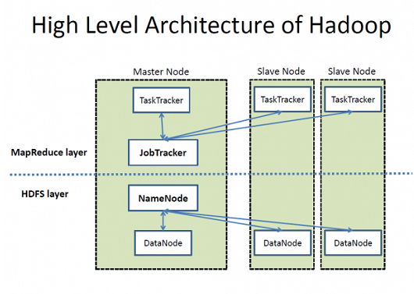
INTRODUCTION

Slide 6
Role of Distributed Storage - HDFS in Hadoop Application Architecture Implementation
A file on HDFS is split into multiple bocks and each is replicated within the Hadoop cluster.
A block on HDFS within the underlying file system with a default size of 64MB.
The size of a block can be extended up to 256 MB based on the requirements.

Slide 7
*Blocks
Now, as we know that the data in HDFS is scattered across the DataNodes as blocks.
Let’s have a look at what is a block and how is it formed?
Blocks are the nothing but the smallest continuous location on your hard drive where data is stored.
In general, in any of the File System, you store the data as a collection of blocks.

Slide 8
*Blocks
Similarly, HDFS stores each file as blocks which are scattered throughout the Apache Hadoop cluster.
The default size of each block is 128 MB in Apache Hadoop 2.x (64 MB in Apache Hadoop 1.x) which you can configure as per your requirement.

Slide 9
*Blocks
It is not necessary that in HDFS, each file is stored in exact multiple of the configured block size (128 MB, 256 MB etc.).
Let’s take an example where we have a file “example.txt” of size 514 MB.
Suppose that we are using the default configuration of block size, which is 128 MB.
Then, how many blocks will be created? 5, Right. The first four blocks will be of 128 MB. But, the last block will be of 2 MB size only.

Slide 10
*Blocks
Now, you must be thinking why we need to have such a huge blocks size i.e. 128 MB?
Well, whenever we talk about HDFS, we talk about huge data sets, i.e. Terabytes and Petabytes of data.
So, if we had a block size of let’s say of 4 KB, as in Linux file system, we would be having too many blocks and therefore too much of the metadata.
So, managing these no. of blocks and metadata will create huge overhead, which is something, we don’t want.

Slide 11
*Blocks
Now, you must be thinking why we need to have such a huge blocks size i.e. 128 MB?
Well, whenever we talk about HDFS, we talk about huge data sets, i.e. Terabytes and Petabytes of data.
So, if we had a block size of let’s say of 4 KB, as in Linux file system, we would be having too many blocks and therefore too much of the metadata.
So, managing these no. of blocks and metadata will create huge overhead, which is something, we don’t want.

Slide 12
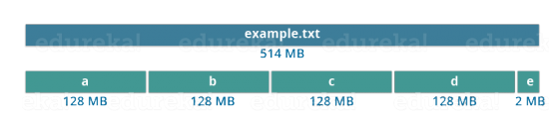
*Blocks

Slide 13
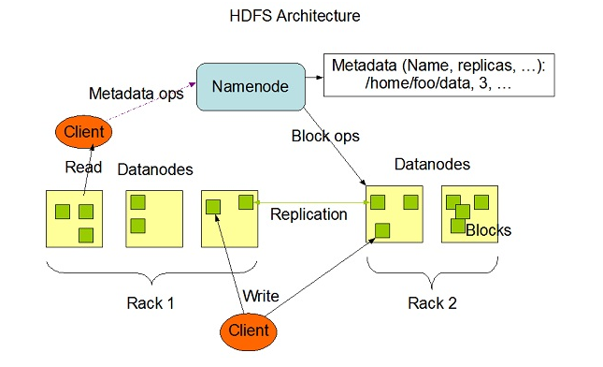
Role of Distributed Storage - HDFS in Hadoop Application Architecture Implementation

Slide 14
Role of Distributed Storage - HDFS in Hadoop Application Architecture Implementation
Hadoop Distributed File System (HDFS) stores the application data and file system metadata separately on dedicated servers.
NameNode and DataNode are the two critical components of the Hadoop HDFS architecture.

Slide 15
Role of Distributed Storage - HDFS in Hadoop Application Architecture Implementation
Application data is stored on servers referred to as DataNodes and file system metadata is stored on servers referred to as NameNode.
HDFS replicates the file content on multiple DataNodes based on the replication factor to ensure reliability of data
The NameNode and DataNode communicate with each other using TCP based protocols.

Slide 16
Role of Distributed Storage - HDFS in Hadoop Application Architecture Implementation
For the Hadoop architecture to be performance efficient, HDFS must satisfy certain pre-requisites –
All the hard drives should have a high throughput.
Good network speed to manage intermediate data transfer and block replications.

Slide 17
Role of Distributed Storage - HDFS in Hadoop Application Architecture Implementation
NameNode:
It is the master daemon that maintains and manages the DataNodes (slave nodes)
It records the metadata of all the files stored in the cluster, e.g. The location of blocks stored, the size of the files, permissions, hierarchy, etc. There are two files associated with the metadata:
FsImage: It contains the complete state of the file system namespace since the start of the NameNode.
EditLogs: It contains all the recent modifications made to the file system with respect to the most recent FsImage.

Slide 18
Role of Distributed Storage - HDFS in Hadoop Application Architecture Implementation
It records each change that takes place to the file system metadata. For example, if a file is deleted in HDFS, the NameNode will immediately record this in the EditLog.
It regularly receives a Heartbeat and a block report from all the DataNodes in the cluster to ensure that the DataNodes are live.
It keeps a record of all the blocks in HDFS and in which nodes these blocks are located.
The NameNode is also responsible to take care of the replication factor of all the blocks

Slide 19
Role of Distributed Storage - HDFS in Hadoop Application Architecture Implementation
In case of the DataNode failure, the NameNode chooses new DataNodes for new replicas,balance disk usage and manages the communication traffic to the DataNodes.

Slide 20
Role of Distributed Storage - HDFS in Hadoop Application Architecture Implementation
DataNode:
DataNodes are the slave nodes in HDFS.
Unlike NameNode, DataNode is a commodity hardware, that is, a non-expensive system which is not of high quality or high-availability.
The DataNode is a block server that stores the data in the local file ext3 or ext4.

Slide 21
Role of Distributed Storage - HDFS in Hadoop Application Architecture Implementation
Functions of DataNode:
These are slave daemons or process which runs on each slave machine.
The actual data is stored on DataNodes.
The DataNodes perform the low-level read and write requests from the file system’s clients.
They send heartbeats to the NameNode periodically to report the overall health of HDFS, by default, this frequency is set to 3 seconds.

Slide 22
Role of Distributed Storage - HDFS in Hadoop Application Architecture Implementation
Secondary NameNode:
Apart from these two daemons, there is a third daemon or a process called Secondary NameNode.
The Secondary NameNode works concurrently with the primary NameNode as a helper daemon.

Slide 23
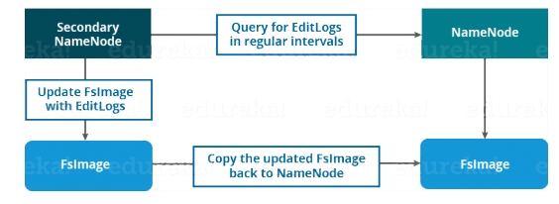
Role of Distributed Storage - HDFS in Hadoop Application Architecture Implementation

Slide 24
Role of Distributed Storage - HDFS in Hadoop Application Architecture Implementation
Functions of Secondary NameNode:
The Secondary NameNode is one which constantly reads all the file systems and metadata from the RAM of the NameNode and writes it into the hard disk or the file system.
It is responsible for combining the EditLogs with FsImage from the NameNode.
It downloads the EditLogs from the NameNode at regular intervals and applies to FsImage. The new FsImage is copied back to the NameNode, which is used whenever the NameNode is started the next time.

Slide 25
Replication Management
HDFS provides a reliable way to store huge data in a distributed environment as data blocks.
The blocks are also replicated to provide fault tolerance.
The default replication factor is 3 which is again configurable.
So, as you can see in the figure below where each block is replicated three times and stored on different DataNodes

Slide 26
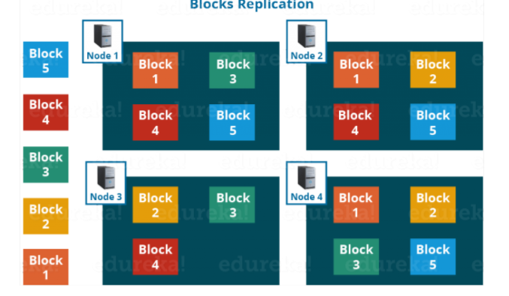
Replication Management

Slide 27
Replication Management
Therefore, if you are storing a file of 128 MB in HDFS using the default configuration, you will end up occupying a space of 384 MB (3*128 MB) as the blocks will be replicated three times and each replica will be residing on a different DataNode.

Slide 28
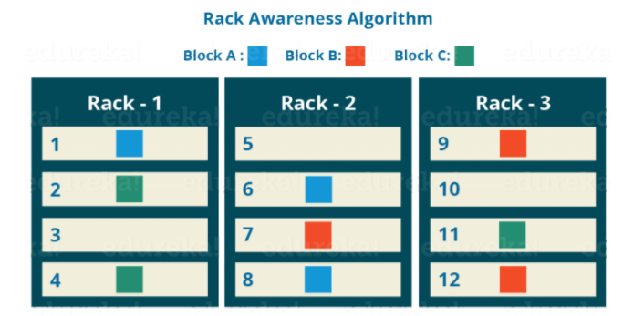
Rack Awareness

Slide 29
Rack Awareness
NameNode also ensures that all the replicas are not stored on the same rack or a single rack.
It follows an in-built Rack Awareness Algorithm to reduce latency as well as provide fault tolerance.

Slide 30
Rack Awareness
Considering the replication factor is 3, the Rack Awareness Algorithm says that the first replica of a block will be stored on a local rack and the next two replicas will be stored on a different (remote) rack but, on a different DataNode within that (remote) rack as shown in the figure above.
If you have more replicas, the rest of the replicas will be placed on random DataNodes provided not more than two replicas reside on the same rack, if possible.

Slide 31
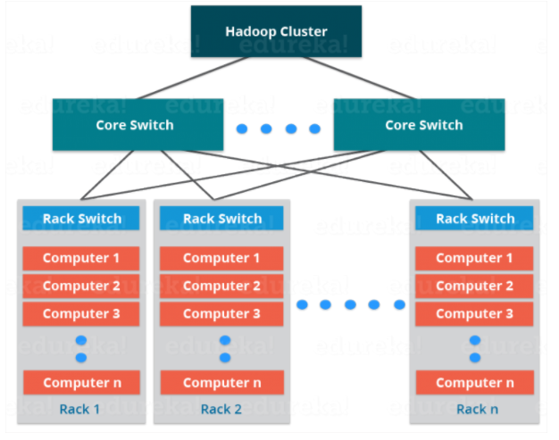
Rack Awareness

Slide 32
Rack Awareness
Advantages of Rack Awareness
To improve the network performance: The communication between nodes residing on different racks is directed via switch. In general, you will find greater network bandwidth between machines in the same rack than the machines residing in different rack

Slide 33
Rack Awareness
To prevent loss of data: We don’t have to worry about the data even if an entire rack fails because of the switch failure or power failure.
And if you think about it, it will make sense, as it is said that never put all your eggs in the same basket.

